Slide 1



F1 CLOUD
MIGRATION
Nabihah, Keaven, Jovan, Fariha, Aden
S10258311F, S10258273A, S10258267D, S10256073A, S10258369C
P02, Group 3

Slide 2

Contents
01
02
03
04
Project Overview
Product & Sprint Backlogs
ELT Pipeline
RBAC
05
06
07
08
CI/CD Pipeline
User Story
Linkage
Task Breakdown
Visualisation Walkthrough

Slide 3

PROJECT OVERVIEW
Company Overview
Current Challenges
Problem Statement
Goals and Objectives

Slide 4
FORMULA 1 OVERVIEW
Formula One (F1) is the premier international motorsport event, renowned for its high-speed, single-seater racing since 1950. With annual events held worldwide, F1 continues to grow in scale and complexity, involving drivers, pit crews, and extensive race logistics.
However, there are significant challenges with F1’s current on-premises data infrastructure; they are as follows:
01

Slide 5




DATA INFRASTRUCTURE CHALLENGES
Inefficiency and High Costs
Limited Scalability
On-premises systems require extensive manpower and resources
Costly and unsustainable as data demands increase
Expanding on-premises databases is time-consuming and labour-intensive
Unable to keep up with F1's growing data volumes and complexity
Data Overload
& Complexity
Operational Challenges
Large datasets (telemetry, GPS, video analysis) lead to slow system response times
Challenges in managing and cleaning data effectively
Global operations require a flexible system
On-premises infrastructure lacks the accessibility for seamless updates across locations
01

Slide 6

PROBLEM STATEMENT
For F1’s data management team, who requires scalable, accessible, and reliable data solutions, we offer the Snowflake Migration Project, which is a cloud-based data migration initiative that enables secure, remote access to data, flexible scaling, and high reliability. Unlike on-premises servers, which have limited scalability and higher downtime risks, our project offers F1 seamless data access, optimised resource use, and improved uptime.

Slide 7



GOALS AND OBJECTIVES
Scalability
Operational Efficiency
Improved Reporting Speed
Seamlessly handle growing data demands
Eliminate manual intervention for capacity expansion
Reduce operational costs
Minimise manpower required for system maintenance
Enhance data processing speed
Enable faster insights for decision-making
01

Slide 8



GOALS AND OBJECTIVES
Data Security
Advanced Analytics
Improved Data Accessibility
Strengthen data protection through cloud-based security measures
Ensure compliance with industry regulations
Provide the data team with advanced tools
Support deeper business insights and data-driven decision-making
Enable remote access from any location
Facilitate real-time updates and collaboration across global operations
01

Slide 9

SNOWFLAKE SELECTION
Scalability: Seamless expansion to handle growing data demands.
Performance: CI/CD support for faster development and team collaboration.
Data Governance: Robust role-based access control for secure data management.
Collaboration: Multi-user access enables efficient teamwork.
Continuous Innovation: Regular updates to meet evolving needs.
Proven Effectiveness: Widely adopted across industries.

Slide 10
ELT PIPELINE WALKTHROUGH
ELT Rundown
Why ELT?
Live Demo

Slide 11
ELT RUNDOWN
The ELT pipeline was designed to migrate the on-premise F1 database to Snowflake for efficient data analysis.
Extract & Load (E/L)
Set up Snowflake warehouse, defined schemas, and recreated tables to structure the data.
Transformation (T)
Consolidated data into key tables, ensuring consistency through cleaning, standardisation, and relationship mapping.
Dynamic tables were introduced in Sprint 5 for automatic updates, enabling seamless integration with Power BI and optimising data processing for accurate reporting.
01
Notes:
The ELT pipeline was designed to migrate the on-premise F1 database to Snowflake for more efficient data analysis. During the Extract and Load phase, a Snowflake warehouse was set up, schemas defined, and tables recreated to establish a structured data environment.
In the Transformation phase, data was consolidated into key tables, ensuring consistency through cleaning, standardisation, and relationship mapping.
Dynamic tables were introduced in Sprint 5, enabling automatic updates and seamless integration with Power BI. This streamlined approach optimised data processing, ensuring accuracy and efficiency in reporting.

Slide 12
WHY ELT?
Greater Flexibility
Raw data remains available
Allows multiple transformation approaches
Faster Data Ingestion
Supports real-time analytics
Processes data in batches for efficiency.
Better Handling of Big Data
Stores unstructured data in data lakes/warehouses before transformation
01
Notes:
The ELT pipeline was designed to migrate the on-premise F1 database to Snowflake for more efficient data analysis. During the Extract and Load phase, a Snowflake warehouse was set up, schemas defined, and tables recreated to establish a structured data environment.
In the Transformation phase, data was consolidated into key tables, ensuring consistency through cleaning, standardisation, and relationship mapping.
Dynamic tables were introduced in Sprint 5, enabling automatic updates and seamless integration with Power BI. This streamlined approach optimised data processing, ensuring accuracy and efficiency in reporting.

Slide 13
ELT PIPELINE WALKTHROUGH

Slide 14
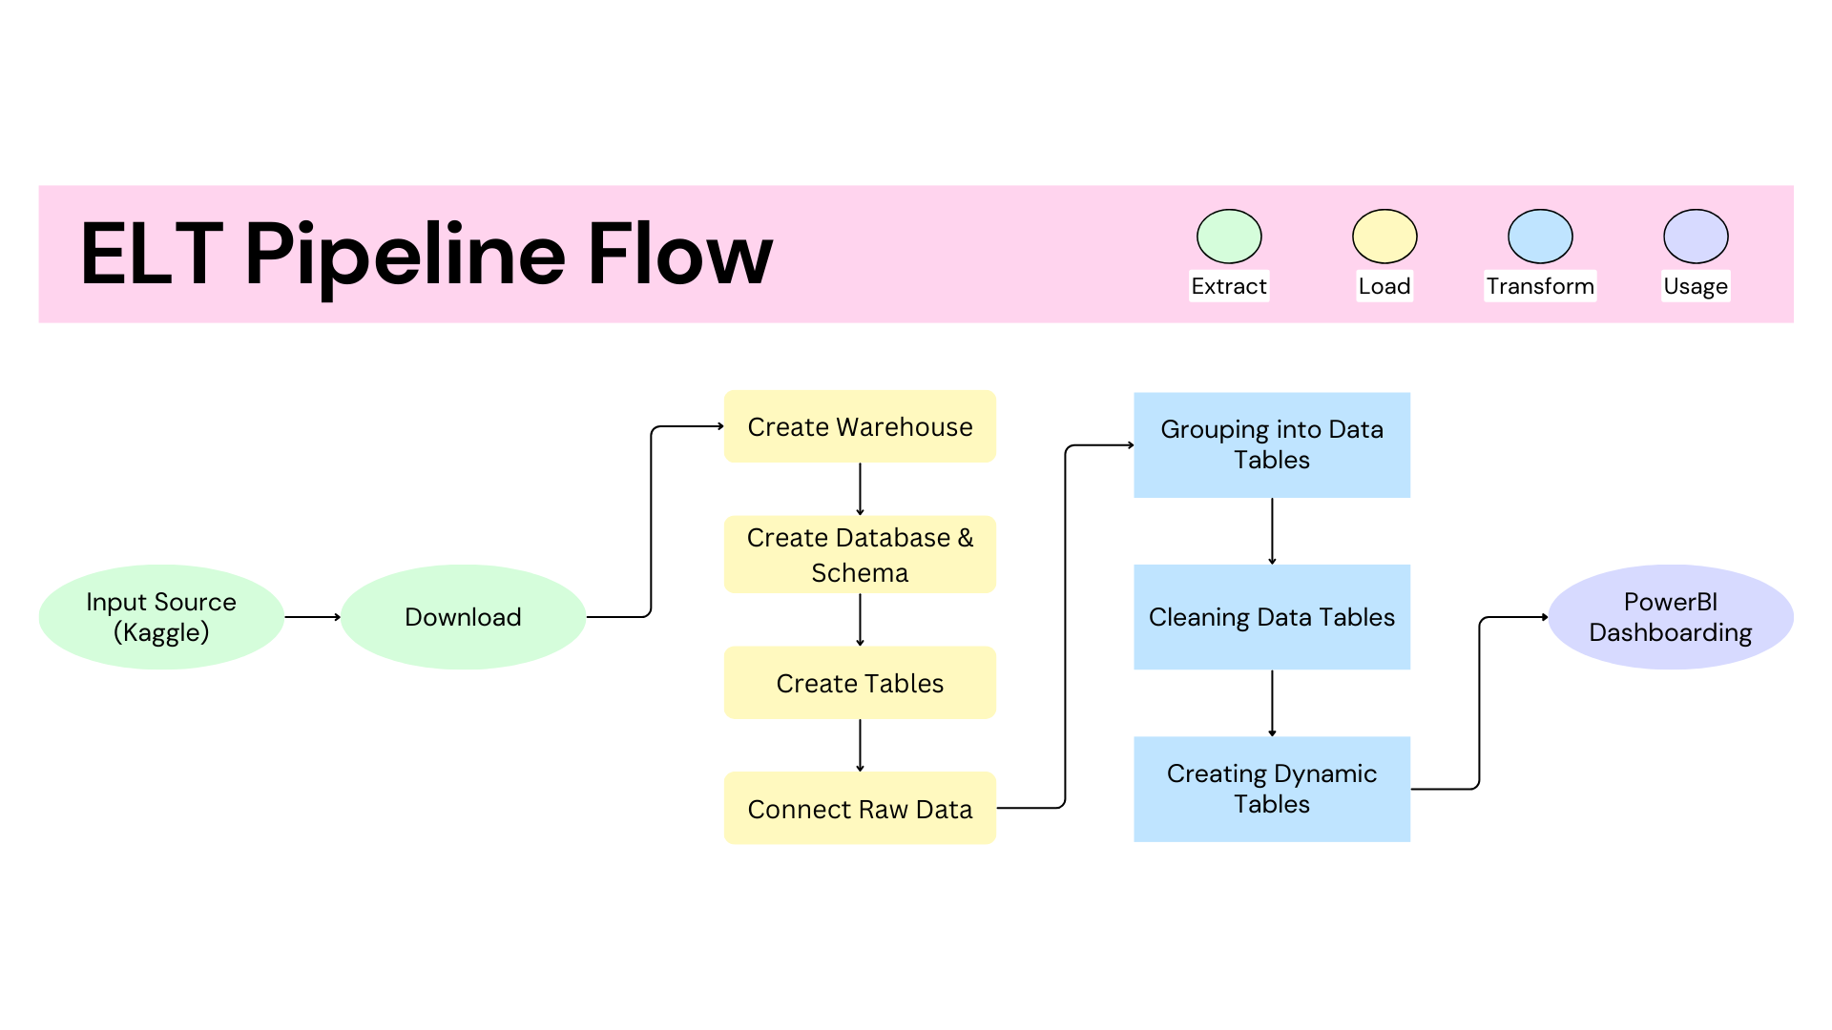

Slide 15
ROLE BASED ACCESS CONTROL
(RBAC)

Slide 16
RBAC
OVERVIEW
We integrated role based access control into the database.
Data security
minimizing the risk of unauthorized access and data breaches by limiting permissions based on assigned roles
Role hierarchy
ensure that correct roles have correct access
Roles made
analyst, developer and CI

Slide 17
RBAC WALKTHROUGH

Slide 18
CI/CD PIPELINE

Slide 19
CI/CD
OVERVIEW
We integrated GitHub with Snowflake using SnowSQL
Increased effiecency
Can pull and push code through Snowflake itself
Reduce Human Errors
Automatically checks for conflicts when pushing
Improved collaboration
Each other work can be easily accessed through the Git repository

Slide 20
CI/CD PIPELINE WALKTHROUGH

Slide 21
USER STORY LINKAGE

Slide 22

USER STORY LINKAGE 1
(Nabihah) As a Motorsport Strategist, I want to analyse race performances, identify driver trends, and evaluate car impact to optimise strategies.
Race Timing Trends
Driver & Car Analysis
Track Performance
Visuals on average race timings by year help identify performance trends and external factors influencing race duration.
Driver and car model win analysis provides insights into top-performing drivers and manufacturers, aiding strategy optimisation.
Race timing comparisons across Grand Prix events help assess track-specific performance, guiding race strategy decisions.

Slide 23
USER STORY LINKAGE 2
(Keaven) As a Team Manager for one of the F1 pit crew, I would like to have a dashboard on the general statistics on F1 in order help change game plans for drivers.
Driver
Teams
Management
Provides performance analysis for the drivers for them to improve and create strategies
Better performance leads to better brand deals since drivers would get better recognition
The performance analysis of this dashboard aid in teams to create competitive strategies
The changes in competitive strategies would attract more spectators and viewership since viewers enjoy the competition.
The performance analysis of this dashboard would aid helping management changing staff members.
If drivers are not performing management would use the aid of this dashboard to help change drivers like team members in the pit crew.

Slide 24
USER STORY LINKAGE 3
(Jovan) As a Data Analyst for Ferrari, I want to leverage the data to see our overall team statistics and individual statistics to help the team decided to either drop a player or help improve our current players.
Track Performance
Overall Team Placement
Driver Placement
Race timing comparisons across Grand Prix events to help accecss which tracks the drivers currently struggle with and should improve
Overall team placement over all the years to see how the players overall performance as a team and if the players are good or not
Average driver placement to see how they place overall throughout the years

Slide 25
USER STORY LINKAGE 4
(Fariha) As a Sports Data Scientist, I want to use a modernised cloud database with defined key relationships to analyse grid positions and recorded times, ensuring accurate identification of key performance indicators that influence race outcomes.
Grid Position Analysis
KPI Identification
Data Integrity
Allows for efficient analysis of grid positions and their correlation to recorded times, enabling deeper insights into race performance.
Enables the identification of key performance indicators (KPIs) that influence race outcomes, providing valuable insights for improving team strategy.
Ensures the integrity and consistency of grid & race data, supporting reliable analysis and eliminating the risk of errors or mismatches in the dataset.

Slide 26
USER STORY LINKAGE 5
(Aden) As a Data Analyst, I leverage tools usage so that I can provide informing dashboards, to provide F1 with deeper understanding of the drivers’ performances as well as how they can improve.
Benchmarking
Performance tracking
Time tracking
Using the visuals such as the quickest drivers based on Grand Prix/year to gain insights as to benchmarking the time taken.
Creating visuals for the maximum number of laps completed so that drivers have a benchmark to aim at.
Time taken for the racers to complete a lap/course so that drivers will know the fastest/average timings.

Slide 27
TASK BREAKDOWN

Slide 28
Warehouse, Database & Schema Creation
Original Tables Creation
Race Table Creation
Cleaning Race Table
Report Sections & Foundation
Slides Foundation & Content
Dynamic Tables
PowerBI Connection
Dashboard
CI/CD
Role Access for CI/CD
Importing F1 Dataset to Snowflake
Team table
Dashboard
Dynamic Table
PowerBI Connection
Importing of data for team related tables
Report Sections & Format
Slides Content
Database creating
Tables creation (Driver table)
Cleaning Driver table
Foreign key and primary key
Dashboard
Importing of data for driver related tables
Nabihah
Keaven
Jovan
Fariha
Aden
Role-Based Access Control
Dynamic Tables
PowerBI Connection
Dashboard
Defining Table “Rules”
Importing F1 Dataset to Snowflake
Joining & Cleaning Grid Table
Testing Role-Based Access
Setting Primary & Foreign Keys
Report Sections & Format
Slides Content
Dashboard

Slide 29
VISUALISATION WALKTHROUGH
Dashboard Introduction
Individual Visualisation
Dashboard Insights

Slide 30
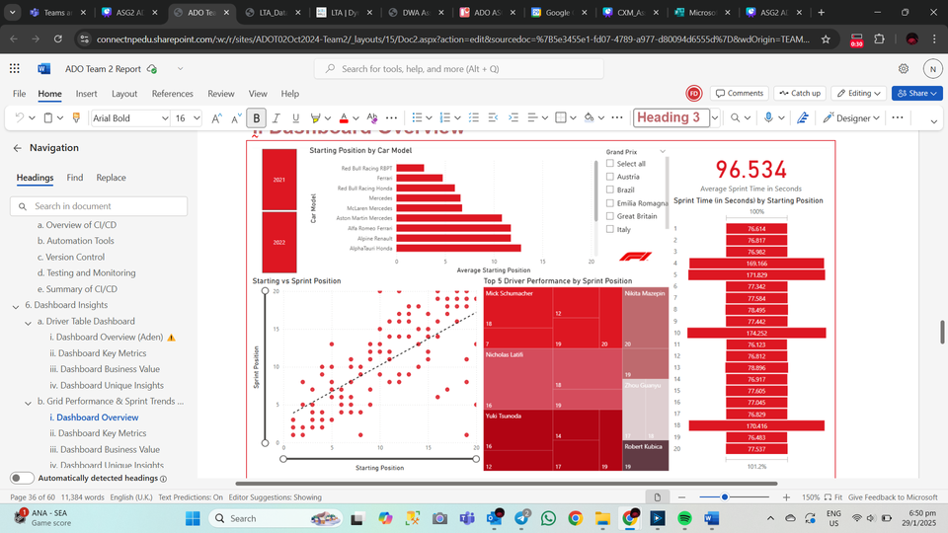
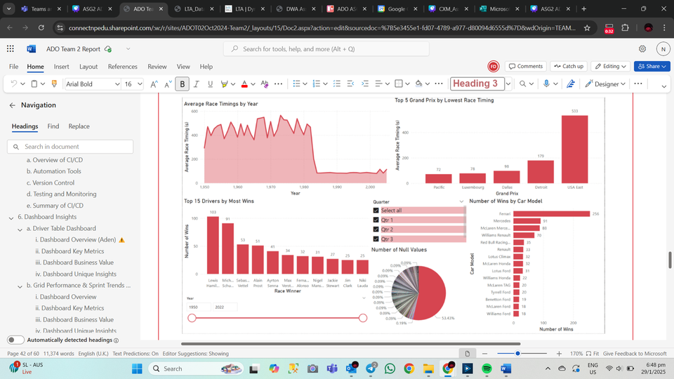

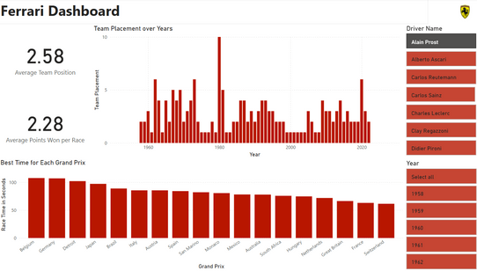
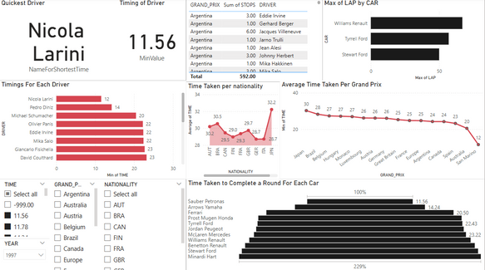
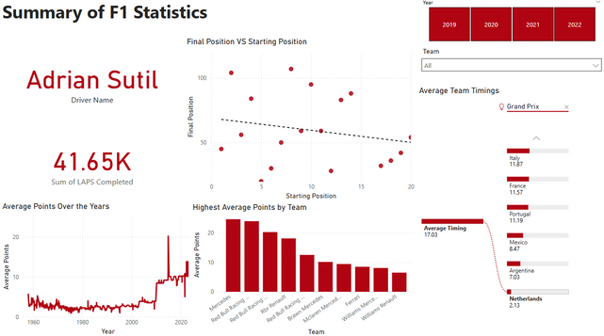
DASHBOARD
INTRODUCTION
This project features five interactive dashboards — Grid Performance & Sprint Trends, Race Performance & Strategy, Team Table Dashboard, Driver Table Dashboard, and Summary of F1 Statistics — designed to provide key insights into F1 race data.
Leveraging data from Snowflake, these dashboards offer comprehensive visualisations on grid analysis, race performance, team standings, driver statistics, and historical trends. By integrating real-time updates through dynamic tables, they enable efficient analysis and data-driven decision-making.
01

Slide 31
THANK
YOU!

